Slide 1
RV Toilet
SFRTPH-01-01/02
Replace straight-type Inlet Valve Kit with L-type Inlet Valve Kit Instructions
直管进水阀组件更换为弯管进水阀组件
操作指引

Slide 2
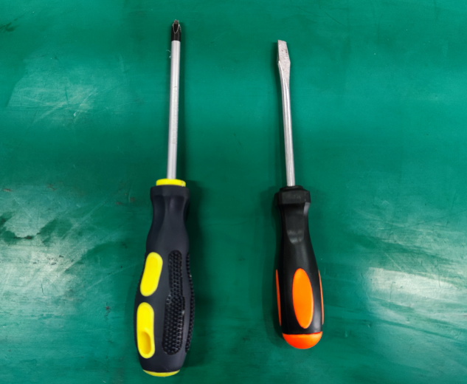
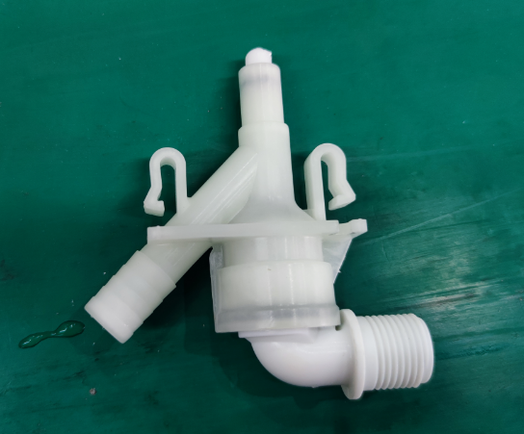
1：Tools and accessories 工具、配件
Tools: 1 pcs Phillips screwdriver 1pcs flat-blade screwdriver
工具：1把十字螺丝刀
1把一字螺丝刀
Accessories: L-type water inlet valve kit
配件：弯头进水阀组件

Slide 3
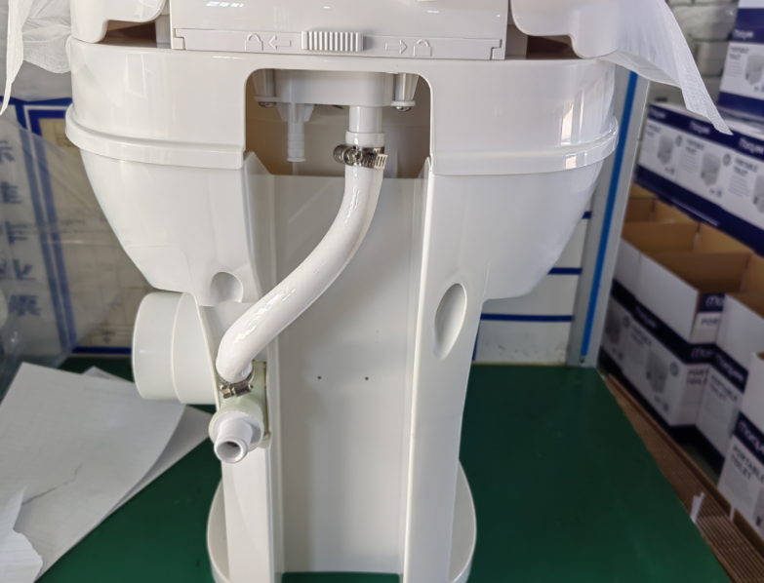
2：Product 产品
Product 产品

Slide 4
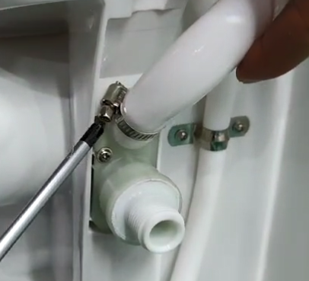
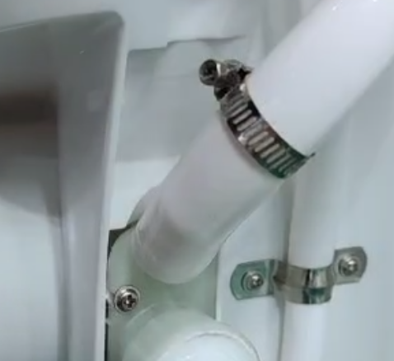
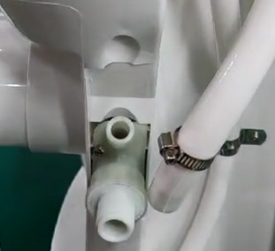
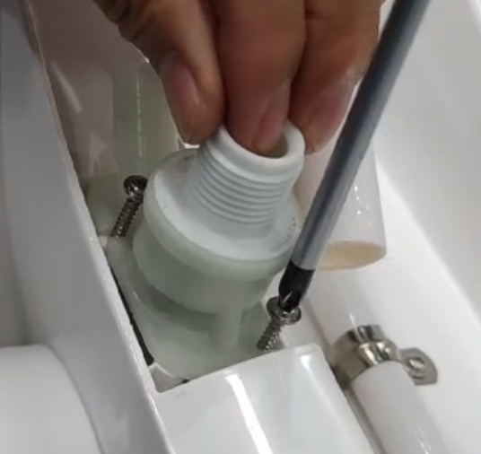
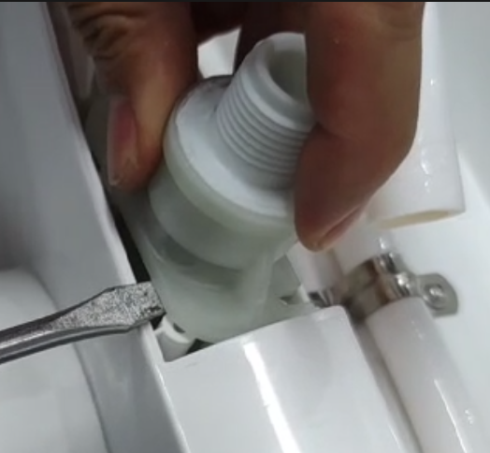
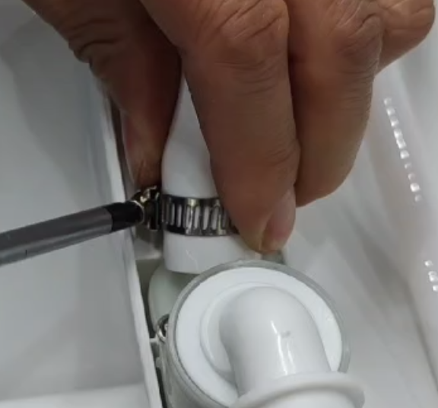
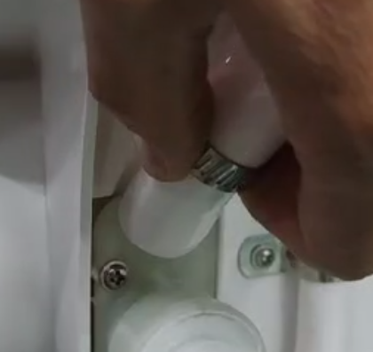
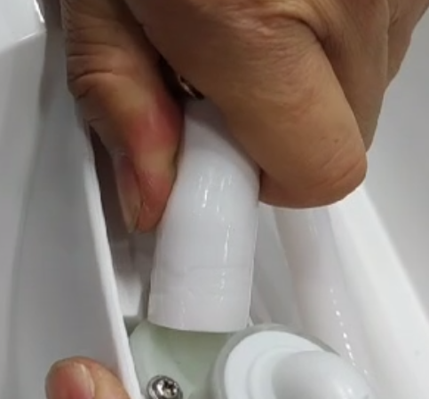
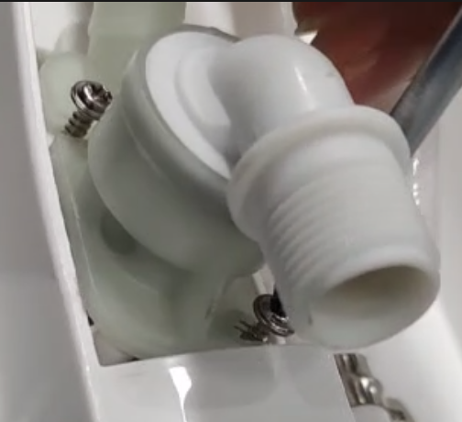
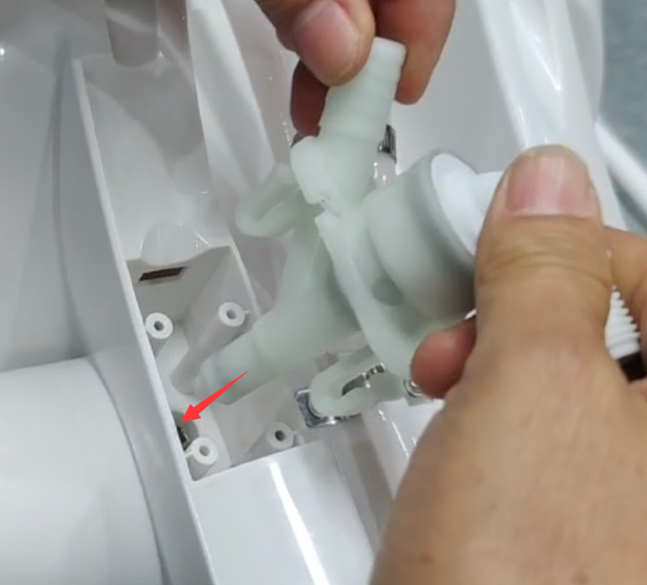
3：Replace the water inlet valve kit
Step 1: Place the toilet on the desk and use a Phillips screwdriver to loosen the screws on the clamp in a counterclockwise direction.
Step 2: After loosening the clamp screw, push the clamp onto the hose.
Step 3: Unplug the hose from the outlet of the water inlet valve kit.
Step 4: Use a Phillips screwdriver to loosen the fixing screws of the water inlet valve kit counterclockwise and take off the screws.
Step 5: Use a flat-blade screwdriver, insert it under the water inlet valve kit (next to the screw column), and pry up to remove the water inlet valve kit.
(Note: If the inverted buckle breaks, turn the disassembly position downward and shake out the broken buckle.)
Step 10: Use a Phillips screwdriver to tighten the clamp screw clockwise, and the replacement of the water inlet valve kit is completed.
Step 9: Push down the clamp. The downward position of the clamp should be at the original indentation of the hose.
Step 8: Put the hose back to the outlet of the water inlet valve assembly, and put it all the way to the end
Step 7: Use a Phillips screwdriver to lock the first screw halfway clockwise, lock the second screw, and then tighten the first screw
Step 6: Align the push rod of the L-type water inlet valve kit with the hole and install it.

Slide 5
3：更换进水阀组件
步骤1：将马桶放置在台面上，使用十字螺丝刀逆时针方向旋松卡箍上的十字螺丝
步骤2：卡箍螺丝旋松后，将卡箍往软管上推
步骤3：从进水阀组件出水口处拔出软管
步骤4：使用十字螺丝刀逆时针方向旋松进水阀组件固定螺丝，取出螺丝
步骤5：使用一字螺丝刀，插入进水阀组件下方（螺丝柱边），向上撬出进水阀组件。
（注：如果倒扣撬断裂，可将拆除位置倒回，将断裂倒扣抖出）
步骤10：十字螺丝刀顺时针锁紧卡箍螺丝，进水阀组件更换完成
步骤9：向下推卡箍，卡箍下移位置要在原先软管压痕处
步骤8：将软管套回进水阀组件出水口，要套到底
步骤7：使用十字螺丝刀，将第1颗螺丝顺时针锁一半，锁第2颗螺丝，锁紧后，再将第1颗螺丝锁紧
步骤6：将弯头进水阀组件推杆对准扣孔位装上

